Slide 1

Project Second Review on
POWER SYSTEM FAULT DIAGNOSIS USING MACHINE LEARNING
by
under the guidance of
Dr . S. Hemachandra M.Tech., Ph.D.
Professor
DEPARTMENT OF ELECTRICAL AND ELECTRONICS ENGINEERING
SREE VIDYANIKETHAN ENGINEERING COLLEGE
(AUTONOMOUS)
A.RANGAMPET, TIRUPATI – 517 102
(2016 - 2020)
EDAGOTTI PAVANKUMAR | 16121A0253
AVILALA DEDEEPYA | 16121A0208
GAYAKAWADA CHANDRASEKHAR | 16121A0265
AVULA PRAVALIKA | 16121A0209

Slide 2
Contents :
Objective
Introduction
Components Information
Simulation Results
Project Time line
Advantages
Conclusion
References
CO – PO Mapping

Slide 3
Objective
Power system fault diagnosis is the process of analyzing historical fault data for the detection and the classification of the current faults.
The objective of our project is to detect and the classify faults with the help of the deep neural networks.

Slide 4
Introduction
From past few decades we are very much depending on the electric power.
Transmission lines are the bridge between generating stations to distribution stations.
Faults in the transmission lines are common but the protection is necessary to protect the system from faults.
The fault detection and the classification in the transmission line is very much important.
By using the deep neural networks we can classify the type of fault occurred in the transmission line, which requires past data.

Slide 5



Components
Here we are using MATLAB to generate the fault data for deep neural networks.
We are using NeuroSolutions software for the training and testing of the network.
We are using Recurrent Neural Network for the classification of shunt faults in the transmission line.
Fig . 1 . Matlab
Fig. 2 . NeuroSolutions
Fig. 3. Microsoft Excel

Slide 6
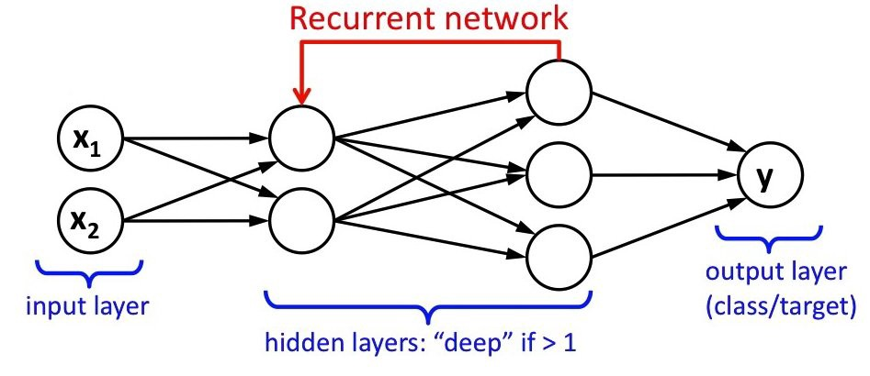
Fig. 4. Recurrent Neural Network

Slide 7
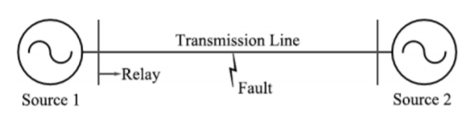
Line Voltage VL-L = 220 kV
Line Length, l = 200 km
Frequency, f = 50 Hz
Z1 = 4.76 + j*59.75 ohms
Z0 = 77.70 + j*204.26 ohms
Fault Types : a-g, b-g, c-g, ab, bc, ac, ab-g, bc-g, ac-g, abc,
no fault
Fault Resistance : 0.001, 5 ,10, 15,20 ohms
Fault Location : 0,50,100,150,200 kms
Fig. 5. Transmission network considered for the simulations

Slide 8
Simulation Results
Best Networks | Training | Cross Validation
Epoch # | 1000 | 1000
Minimum MSE | 0.001670653 | 0.001660362
Final MSE | 0.001670653 | 0.001660362
Table. 1. Training Results
Fig. 6. MSE vs Epoch for Training with 5 hidden layers

Slide 9
Output / Desired | Fault(BCG) | Fault(BG) | Fault(BC) | Fault(AB) | Fault(AG) | Fault(CAG) | Fault(CG) | Fault(ABG) | Fault(CA) | Fault(ABC) | No Fault
Fault(BCG) | 611 | 0 | 0 | 0 | 0 | 0 | 0 | 0 | 0 | 0 | 0
Fault(AG) | 0 | 614 | 0 | 0 | 0 | 0 | 0 | 0 | 0 | 0 | 0
Fault(BC) | 0 | 0 | 670 | 0 | 0 | 0 | 0 | 0 | 0 | 0 | 0
Fault(AB) | 0 | 0 | 0 | 615 | 0 | 0 | 0 | 0 | 0 | 0 | 0
Fault(AG) | 0 | 0 | 0 | 0 | 645 | 0 | 0 | 0 | 0 | 0 | 0
Fault(CAG) | 0 | 0 | 0 | 0 | 0 | 591 | 0 | 0 | 0 | 0 | 0
Fault(CG) | 0 | 0 | 0 | 0 | 0 | 0 | 607 | 0 | 0 | 0 | 0
Fault(ABG) | 0 | 0 | 0 | 0 | 0 | 0 | 0 | 656 | 0 | 0 | 0
Fault(CA) | 0 | 0 | 0 | 0 | 0 | 0 | 0 | 0 | 619 | 0 | 0
Fault(ABC) | 0 | 0 | 0 | 0 | 0 | 0 | 0 | 0 | 0 | 620 | 0
No Fault | 0 | 0 | 0 | 0 | 0 | 0 | 0 | 0 | 0 | 0 | 252
Table. 2. Classification Results

Slide 10
Performance | Fault(BCG) | Fault(BG) | Fault(BC) | Fault(AB) | Fault( AG) | Fault(CAG) | Fault(CG) | Fault(ABG) | Fault(CA) | Fault(ABC) | No Fault
MSE | 0.001041384 | 0.001228503 | 0.001267962 | 0.000949011 | 0.00103155 | 0.000609621 | 0.000751261 | 0.001670856 | 0.001259615 | 0.000699633 | 0.000936641
NMSE | 0.012227989 | 0.014361976 | 0.013714801 | 0.011078389 | 0.011540652 | 0.007375399 | 0.008873446 | 0.018414151 | 0.014619167 | 0.008108269 | 0.025133817
MAE | 0.023881474 | 0.030720223 | 0.026290921 | 0.024074968 | 0.02712062 | 0.019775526 | 0.022480201 | 0.033857771 | 0.027864911 | 0.020467848 | 0.024376238
Min Abs Error | 3.10014E-05 | 3.7502E-06 | 4.12587E-07 | 6.64737E-07 | 1.8618E-05 | 4.956E-06 | 6.39238E-06 | 9.19265E-05 | 1.13233E-05 | 5.68566E-06 | 7.6094E-06
Max Abs Error | 0.222116585 | 0.083063903 | 0.222004191 | 0.174415037 | 0.080086244 | 0.194371308 | 0.081007194 | 0.178581559 | 0.273691945 | 0.128971428 | 0.104476299
r | 0.996169263 | 0.993366015 | 0.994160264 | 0.994680123 | 0.994845309 | 0.996420527 | 0.997417854 | 0.993264984 | 0.996228945 | 0.997105661 | 0.988280479
Table. 3. Classification Results

Slide 11
Project Time line
S. No | Work | Number of weeks
1 | Training other deep networks | 4
2 | Validation of results | 2
3 | Thesis submission | 2

Slide 12
Advantages
Power System reliability gets improved
Power System Stability gets improved
Accurate real-time fault classification can support superior grid operation by reducing the likelihood of relay operations on non-faulted phases

Slide 13
Conclusion
Recurrent Neural Network is exercised by varying the hidden layers. We will try to simulate more number of faults and the results will be updated.

Slide 14
References
[1] | K. Chen, J. Hu and J. He, "Detection and Classification of Transmission Line Faults Based on Unsupervised Feature Learning and Convolutional Sparse Autoencoder," in IEEE Transactions on Smart Grid, vol. 9, no. 3, pp. 1748-1758, May 2018.
[2] | S. Shi, B. Zhu, S. Mirsaeidi and X. Dong, "Fault Classification for Transmission Lines Based on Group Sparse Representation," in IEEE Transactions on Smart Grid, vol. 10, no. 4, pp. 4673-4682, July 2019.
[3] | W. Li, D. Deka, M. Chertkov and M. Wang, "Real-Time Faulted Line Localization and PMU Placement in Power Systems Through Convolutional Neural Networks," in IEEE Transactions on Power Systems, vol. 34, no. 6, pp. 4640-4651, Nov. 2019.
[4] | B. Bhattacharya and A. Sinha, "Intelligent Fault Analysis in Electrical Power Grids," 2017 IEEE 29th International Conference on Tools with Artificial Intelligence (ICTAI), Boston, MA, 2017, pp. 985-990.
[5] | H. A. Tokel, R. A. Halaseh, G. Alirezaei and R. Mathar, "A new approach for machine learning-based fault detection and classification in power systems," 2018 IEEE Power & Energy Society Innovative Smart Grid Technologies Conference (ISGT), Washington, DC, 2018, pp. 1-5.
[6] | G. Cardoso, J. G. Rolim and H. H. Zurn, "Application of neural-network modules to electric power system fault section estimation," in IEEE Transactions on Power Delivery, vol. 19, no. 3, pp. 1034-1041, July 2004.
[7] | Jamil, M., Sharma, S.K. & Singh, R. SpringerPlus (2015) 4: 334. https://doi.org/10.1186/s40064-015-1080-x.

Slide 15
CO – PO Mapping
 | CO 1 | CO2 | CO3 | CO4 | CO5 | CO6 | CO7 | CO8 | CO9 | CO10 | CO11 | CO12
PO1
PO2
PO3
PO4
PO5
PO6
PO7
PO8
PO9
PO10
PO11
PO12

Slide 16


